Slide 1
Mobile IP
Mobile Computing

Slide 2
What is mobility?
spectrum of mobility, from the network perspective:
no mobility
high mobility
mobile user, using
same access point
mobile user, connecting/ disconnecting from network using DHCP.
mobile user, passing through multiple access point while maintaining ongoing connections (like cell phone)
From J.F Kurose and K.W. Ross

Slide 3
Mobility Requirements: Network Layer
Maintain connectivity while user roams
Allow IP to integrate transparently with roaming hosts
Address translation to map location-independent addressing to location dependent addressing
Packet forwarding
Location directory
Provide connection to packet flow as opposed to datagram (connection oriented networks)
Support multicast, anycast
Ability to switch interfaces on the fly to migrate between failure-prone networks
Ability to provide quality of service: what is QoS in this environment?
Notes:
Anycast is a network service that delivers a datagram to any one server out of a group of servers distributed throughout the network. As originally introduced in RFC 1546, anycast is a way to reach the mirror that is the closest (measuring network hops). However, the closest mirror server is not always the best mirror server. Some applications are more sensitive to server load, or latency between client and server, or throughput between the client and server. In the limit, every application will have a particular set of metrics for determining which mirror server a client should contact.
Application-Aware Anycast

Slide 4
Mobility Constraint: Network Layer
Unaware hosts running IP
Route management for mobile hosts needs to be dynamic
A backbone may not exist (ad-hoc network)

Slide 5
Network Layer Options
Mobile IP and its variants
Two-tier addressing (location independent addressing <-> location dependent addressing)
A smart forwarding agent which encapsulates packets from unaware host to forward them to MH
Location directory for managing location updates)
Connection-oriented mobility support
Multicast
Finding the first branch point and rerouting packets
Ad hoc routing
Shortest path, source routing, multipath routing

Slide 6
Impact of Mobility: Transport Layer
Requirements:
Congestion control and rate adaptation
Doing the right thing in the presence of different packet losses
Handling different losses (mobility-induced disconnection, channel, reroute)
Improve transient performance
Constraints:
Typically unaware of mobility, yet is affected by mobility
Packet may be lost due to congestion, channel error, handoffs, change of interfaces, rerouting failures
Link-layer and transport layer retransmit interactions

Slide 7
Transport Layer Options
Provide indirection
Make transport layer at the end hosts ware of mobility
Provide smarts in intermediate nodes (e.g. BS) to make lower-layer transport aware
Provide error-free link layers
Notes:
indirection. These solutions
assume a physical or a logical indirection point
interposed between the sender and the receiver(s) that
relays the traffic between them. By communicating
through the indirection point rather than directly to the
end-host, a sender can abstract away the location and the
number of receivers. For instance, mobile IP assumes
a home agent that hides the end-host mobility, while IP
multicast assumes a logical indirection point (address)
that hides the number of receivers and their locations.
www.cs.rice.edu/Conferences/IPTPS02/166.pdf

Slide 8
Impact of Mobility: Operating Systems
Requirements:
Provide the same environment to the user whether mobile (partially connected) or on the backbone network: same files, same context, ability to run same programs, access the same databases, servers & services, retain the same ID
Provide an abstraction of the environment for the aware application to adapt intelligently
Constraints:
Scheduling limited CPU resources & limited energy
Limited disk, memory
Partial connectivity

Slide 9
Impact of Mobility: File Systems
Requirements:
Access the same file as if connected
Retain the same consistency semantics for shared files as if connected
Availability and reliability as if connected
ACID (atomic/recoverability, consistent, isolated/serializable, durable) properties for transactions
Constraints:
Disconnection and/or partial connection
Low bandwidth connection
Variable bandwidth and latency connection,
Connection cost

Slide 10
File systems
Four major aspects of disconnected or partially connected operations:
Hoarding: what to pre-fetch
Consistency: what to keep consistent when connectivity is partial
Emulation: how to operate when disconnected
Conflict resolution: how to resolve conflicts
Many choices within each aspect

Slide 11
Impact of Mobility: Applications/Services
A few questions for application designs:
How much to know about mobility (dynamic state)?
How much to control the activity of OS?
How to structure the interaction btw. App and systems
How to write location-aware applications?
What kind of filtering, data retrieval, and control support to be provided at the backbone?

Slide 12
Mobility: Vocabulary
home network: permanent “home” of mobile
(e.g., 128.119.40.0/24)
home agent: entity that will perform mobility functions on behalf of mobile, when mobile is remote
wide area network
Permanent address: address in home network, can always be used to reach mobile
e.g., 128.119.40.186
correspondent

Slide 13
Mobility: more vocabulary
visited network: network in which mobile currently resides (e.g., 79.129.13/24)
Permanent address: remains constant (e.g., 128.119.40.186)
Care-of-address: address in visited network.
(e.g., 79,129.13.2)
wide area network
home agent: entity in visited network that performs mobility functions on behalf of mobile.
correspondent: wants to communicate with mobile

Slide 14
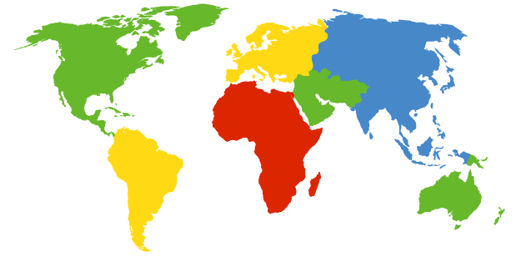


How do you contact a mobile friend:
Consider a friend frequently changing addresses, how do you find her?
search all phone books?
call her parents?
expect her to let you know where he/she is?
I wonder where Alice moved to?

Slide 15
Mobility: Approaches
Let routing handle it: routers advertise permanent address of mobile-nodes-in-residence via usual routing table exchange.
routing tables indicate where each mobile is located
no changes to end-systems
not
scalable
to millions of
mobiles
Let end-systems handle it:
indirect routing: communication from correspondent to mobile goes through home agent, then forwarded to remote
direct routing: correspondent gets foreign address of mobile, sends directly to mobile

Slide 16
Mobility: registration
visited network
home network
1
2
wide area network
mobile contacts foreign agent on entering visited network
foreign agent contacts home agent home: “this mobile is resident in my network”
End result:
Foreign agent knows about mobile
Home agent knows location of mobile

Slide 17
Mobility via Indirect Routing
foreign agent receives packets, forwards to mobile
home agent intercepts packets, forwards to foreign agent
visited
network
home
network
3
wide area network
2
1
correspondent addresses packets using home address of mobile
4
mobile replies directly to correspondent

Slide 18
Indirect Routing: comments
Mobile uses two addresses:
permanent address: used by correspondent (hence mobile location is transparent to correspondent)
care-of-address: used by home agent to forward datagrams to mobile
foreign agent functions may be done by mobile itself
triangle routing: correspondent-home-network-mobile
inefficient when correspondent, mobile are in same network

Slide 19
Forwarding Datagrams
foreign-agent-to-mobile packet
packet sent by home agent to foreign agent: a packet within a packet
dest: 128.119.40.186
dest: 79.129.13.2
dest: 128.119.40.186
Permanent address: 128.119.40.186
Care-of address: 79.129.13.2
dest: 128.119.40.186
packet sent by correspondent

Slide 20
Indirect Routing: Moving Between Networks
Suppose mobile user moves to another network
registers with new foreign agent
new foreign agent registers with home agent
home agent updates care-of-address for mobile
packets continue to be forwarded to mobile (but with new care-of-address)
Changing foreign networks is transparent: ongoing connections can be maintained!

Slide 21
Mobility via Direct Routing
foreign agent receives packets, forwards to mobile
correspondent forwards to foreign agent
visited
network
home
network
4
wide area network
2
3
5
correspondent requests, receives foreign address of mobile
1
mobile replies directly to correspondent

Slide 22
Mobility via Direct Routing: comments
triangle routing problem gone
non-transparent to correspondent: must get new care-of-address from home agent
What happens if mobile changes networks?

Slide 23
Mobile IP
RFC 3344 August 2002, RFC 4721 January 2007
has many features we’ve seen:
home agents, foreign agents, foreign-agent registration, care-of-addresses, encapsulation (packet-within-a-packet)
three components:
agent discovery
registration with home agent
indirect routing of datagrams
Notes:
http://www.tcpipguide.com/free/t_MobileIPOverviewHistoryandMotivation.htm#Figure_127

Slide 24
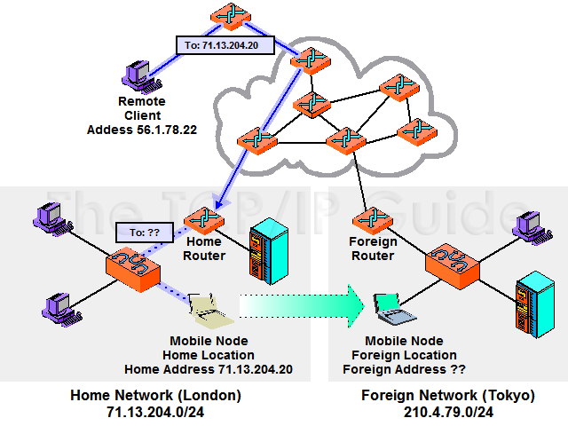
Example from www.tcpipguide.com
A mobile device has been moved from its home network in London to another network in Tokyo. A remote client (upper left) decides to send a datagram to the mobile device. However, it has no idea the device has moved. Since it sends using the mobile node’s home address, 71.13.204.20, its request is routed to the router responsible for that network, which is in London. Of course the mobile device isn’t there, so the router can’t deliver it.

Slide 25
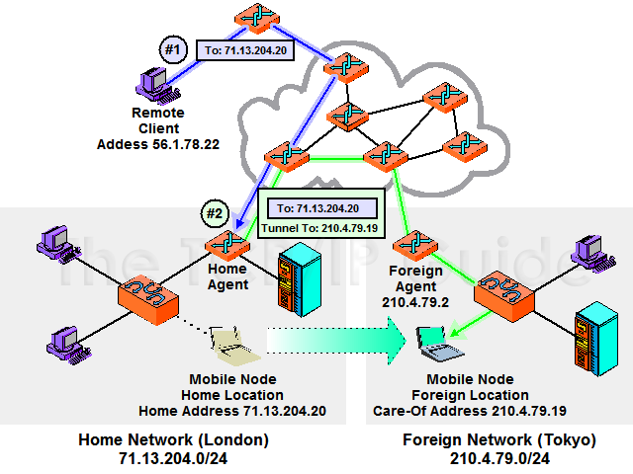
With a co-located care-of address
The mobile node’s home router serves as home agent and the router in Tokyo as the foreign agent. The mobile has been assigned a temporary, “care-of” address to use while in Tokyo (which in this case is a co-located care-of address, meaning that it is assigned directly to the mobile node). In step #1, the remote client sends a datagram to the mobile using its home address, as before. It arrives in London as usual. In step #2, the home agent encapsulates that datagram in a new one and sends it to the mobile node in Tokyo.

Slide 26
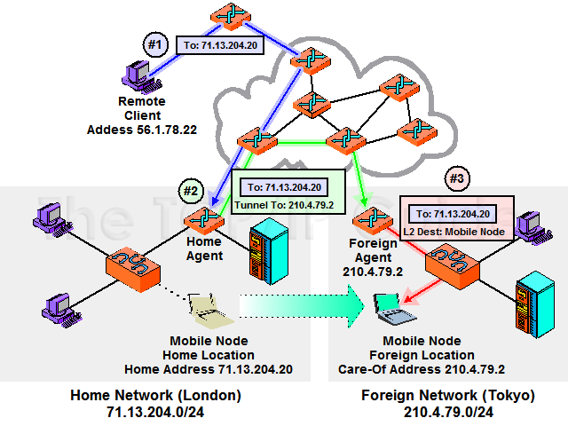
Foreign Agent “Care-Of” Address
The mobile node is using a foreign agent care-of address. This means that the node’s care-of address is actually that of the foreign agent itself. Step #1 is the same as previous slide, but in step #2 the home agent forwards not to the mobile node directly, but to the foreign agent (since that router is the one whose IP address the mobile is using). In step #3 the foreign agent strips off the home agent’s packaging and delivers the original datagram to the mobile node. This is typically done using whatever layer two (LAN or wireless LAN) technology connects the mobile node and foreign agent together.

Slide 27
Mobile IP: Agent Discovery
agent advertisement: foreign/home agents advertise service by broadcasting ICMP messages (type = 9)
RBHFMGV bits
H,F bits: home and/or foreign agent
R bit: registration request

Slide 28
Mobile IP: Registration Example

Slide 29
Design Details: IP Mobility Support
Basic idea of IP mobility management
understand the issues of network-layer mobility support in IP network
understand the basic design principles underlying all mobility support schemes
Internet standards:
Mobile IPv4 –RFC 3344, RFC 4721
RFC 6275 Mobility Support in IPv6, July 2011
Fast handover solutions

Slide 30
Network Support for Mobility
In TCP/IP, the host IP address plays two roles:
acts as an end-point identifier for connections involving the host
a host address should always remain the same
provides routing info for packets destined for the host
a host address should change whenever the host moves
Goal: support mobility without having to change the protocols in all the millions of hosts currently on the Internet

Slide 31
Two Tier Addressing
We need an address pair to identify a MH at any time:
Mobile host (MH): a host that moves
Home address for identification
current address for routing
How to do two-tier addressing:
not physically done (which requires 8 bytes of address per host)
perform address translation along the way by some specialized agents that cache both addresses.

Slide 32
A Mobile Network Layer Arch
Home address (HA): a location-independent address for a MH
Home network: the network identified by the net id part of the HA of MH. A home net has some special agents for proxy-arp, packet forwarding, address translation etc. to support mobility.
When a MH moves within its home network, no network-level support is needed since packet forwarding is achieved by bridges
When a MH moves across networks, the HA cannot be used for routing, though the HA has to be used for end-point identification by TCP.

Slide 33
Architecture cont. : Forwarding Agent
Current address must refer to the (foreign) network when a MH is in a (foreign) network
Packets destined for the MH contain the address of a Forwarding Agent (FA).
FA forwards packets to the MH
If FA and MH are directly connected, FA simply replaces the destination address with the Home Address of the MH
otherwise, FA has to forward the packet to other FAs till the packet reaches the MH
Note that the router/agent that is the last hop to the MH must be mobility aware, since it has to do the final address translation from FA to MH
example: base stations act as FAs

Slide 34
Architecture cont.: Location Directory
Location directory (LD) provides the mapping between the home address and forwarding address for a MH.
MH is responsible for sending updates to the LD when it moves.
LD is distributed.
Typically, the Home network maintains LD for its MHs, though parts of the LD are allowed to be cached by other foreign networks.

Slide 35
Architecture cont.: Address Translation
When a source communicates with a MH, the source puts HA in the destination address field.
Somewhere along the route, this has to pass thru an address translation agent (ATA), which converts the HA to the forwarding address.
Address Translation can be provided by:
IP-IP Encapsulation: Encapsulate the original datagram within another datagram that contains the FA address.
Loose source routing LSR: Indicate intermediate hops over which the datagram must travel to the final destination. In this case, the intermediate hop will be the FA, which then converts the packet address to the final destination.

Slide 36
Architecture Cont.: Packet Forwarding
Source sends out packets addressed to HA of MH
ATA maps HA to FA (using IPIP or LSR)
Packets arrive at FA
FA remaps address to HA and delivers packets over the last hop
At the MH, the packet seems to arrive from Source to HA; thus, network layer has provided transparency
What if the final FA and the MH were co-located ? Optimizations in this case ?

Slide 37
Mobile IPv4
Macro-management for mobility
less frequent than once per second
More concerned about long-term performance: whether to allow seamless mobility or not
Two scenarios for packet forwarding:
MH to a static host: as usual
a static host to a MH: needs Mobile IP

Slide 38
Mobile IPv4 mapped to the Arch
Forwarding agent: co-located with foreign agent or with MH (if DHCP is used)
Location Directory: at home router only
Address Translation Agent: co-located with home router
Location Update Protocol: caching of LD is not allowed; when a MH moves, only the primary copy is modified.

Slide 39
Mobile IPv4 mapped …
Home agent: a router on a MH’s home network which tunnels datagrams for delivery to the MH when it is away from home, maintains LD for MH
Foreign agent: a router on a MH’s visited network which provides routing services to the MH while registered. FA detunnels and delivers datagrams to the MH that were tunneled by the MH’s HA.
Care-of Address: termination point of a tunnel toward a MH, for datagrams forwarded to the MH while it is away from home.
Foreign agent care-of address: the address of a foreign agent that MH registers with.
co-located care-of address: an externally obtained local address that a MH gets.

Slide 40
Mobile IPv4 Protocol Overview
Mobility agents (FAs & HAs) advertise their presence
MH receives the agent advertisements & determines whether it is on its home net or a foreign net
Home net: MH operates without mobility service
Foreign net: obtains a care-of address on the foreign net (via FA’s agent advertisements or DHCP)
if away from home, MH registers its new care-of address with its HA thru a registration request/response process (possibly via a FA).
Datagram sent to the MH’s home address:
intercepted by its home agent,
tunneled by the HA to the MH’s care-of address,
detunneled at the tunnel endpoint (either a FA or MH itself),
and finally delivered to the MH
In the reverse direction: use standard IP routing.

Slide 41
Agent Discovery
Method used by a MH to determine whether it is in its home net or a foreign net may allow MH to determine the foreign agent care-of address
Mobile IP extends ICMP router discovery as its mechanism for Agent Discovery
agent advertisement & agent solicitation
Agent advertisement:
lifetime: maximum length of time that the Advertisement is considered valid in the absence of further Advertisement
if sent periodically, allows a MH to miss 3 Adv messages before deleting the agent from its list.
If it can serve as a FA, must announce its FA care of address
HA must always be prepared to serve the MHs for which it is the HA.
FA may announce it is too busy to handle additional MHs, but must still continually send out the Adv messages.
Agent solicitation: must be implemented by a MH

Slide 42
Registration
A mechanism for MHs to communicate their current reachability info to their HA.
MHs use registration to
request forwarding service when it is in a foreign network
inform their HA of their current care-of address
renew a registration which is due to expire
deregister when they return home
registration via a FA:
If a MH is registering a FA care-of address
if a MH is using a co-located care-of address and receives an Agent Adv from a FA if the “Registration req” bit is set in the Adv message
registration directly with HA:
MH is using a co-located care-of address and not in the above case
when MH returns to home net

Slide 43
Registration
Via FA:
MH sends a Registration Request to the FA
FA receives the request and relays it to the HA
HA sends a Registration Reply to the FA to grant/deny the registration request
FA processes the Registration Reply and relays it to the MH
Directly with HA:
exchanges Request/Reply with HA directly
After a successful registration HA creates/modifies the entry for the MH:
MH’s care-of address, remaining lifetime of the registration, ID field from the Registration Reply

Slide 44
Routing Consideration
Foreign Agent:
maintains a visitor list
when receives an encapsulated datagram, compare the inner destination address to entries in its visitor list; route datagrams.
Home Agent:
intercept any datagrams on the home net addressed to the MH when the MH is away from home
use Proxy and gratuitous ARP:
when a MH is registered on a foreign net, its HA uses proxy ARP to reply to ARP request that seeks the MH’s link-layer address
when MH leaves/returns its home net, its HA uses gratuitous ARP to update the ARP caches of nodes on the home net, causing such nodes to associate the link-layer address of the HA with the MH’s home IP address
Proxy ARP: an ARP reply sent by one node on behalf of another in response to an ARP request. The proxy supplies its own link-layer address in the reply.
Gratuitous ARP: an ARP packet sent by a node to spontaneously cause others to update an entry in their ARP cache.

Slide 45
Co-located Care-of Address via DHCP
DHCP client sends a DHCP_DISCOVER or DHCP_REQUEST
When it sees an address request, it picks one of the addresses from its pool and responds with the DHCP_OFFER.
DHCP client receives the address, and responds with a DHCP_REQUEST confirming acceptance. The server then binds the address to the client, and responds with a DHCP_ACK.
DHCP client may proceed with its registration process.

Slide 46
Mobile IP with Route Optimization
Idea: Correspondent host can learn the care-of address for a MH, and creates a valid binding (LD cache entry) for a MH, and becomes Address Translation Agent
Idea: Correspondent can encapsulate packets directly to the care-of address of MH (thus bypassing the HA), just as the HA does in the basic Mobile IP spec. Correspondent can also use minimal encapsulation as an abbreviated style of encapsulation (8 bytes addition to the IP datagram)
updating binding caches?
only when it received and authenticated the MH’s mobility binding
when HA intercepts a datagram and tunnels it to the MH, HA sends a Binding Update message to the sender
when FA sees that MH is not on its visitor list, it sends HA a Binding Warning message, advising HA to send a Binding Update message to the MH

Slide 47
Route Optimization (contd)
Foreign Agent Smooth Handoff (this is so-called fast handover, to be talked further)
In basic Mobile IP, datagrams in flight may be lost during handoff since HA forwarded those packets to the old FA.
Solution: old FA is notified of the MH’s new FA via a Binding Update message from the new FA, and forwards datagrams in flight to the MH’s new care-of address
Summary
Forwarding agent: same as basic mobile IP
Location Directory: correspondent hosts can cache LD entries
Address Translation Agent: co-located with correspondent hosts
Location update: HA is responsible for sending Binding Update message

Slide 48
Mobile IPv6
Mobility support is a basic requirement for IPv6 design
Key differences from Mobile IPv4:
support for route optimization becomes a fundamental part of the protocol, not an optional part as in Mobile IPv4
no need to deploy foreign agents any more
packets sent to a MH while away from home are tunneled using an IPv6 Routing header (analogous to loose source routing in IPv4) rather than IP encapsulation
MH is always responsible for delivering binding updates to its correspondence hosts

Slide 49
Mobile IPv6
Forwarding agent: co-located with MHs
Location directory: LD is maintained at home router. Cache entries are acquired thru Binding Update messages issued by MHs
Address Translation Agent: colocated with all hosts and home routers
Location Update: MH is responsible for updating the primary copy and all LD cache entries.

Slide 50
Fast Handover
So far we only cared about the long-term performance, what about during the handovers?
Will lose packets in flight, hard for TCP to swallow
Handover across geographically adjacent subnets happens most often in practice
Fast handover seeks to solve this problem

Slide 51
Idea Behind Fast Handover
Set up a forwarding tunnel between the old access router and the new access router
The old access router forwards all the packets through the tunnel to the new access router, which delivers them to the MH
Several solution proposals so far:
MAC bridge based
Proposal within M-IPv6

Slide 52
Extra slides

Slide 53
Encapsulation
original IP header
original data
new IP header
new data
outer header
inner header
original data

Slide 54
Encapsulation I
Encapsulation of one packet into another as payload
e.g. IPv6 in IPv4 (6Bone), Multicast in Unicast (Mbone)
here: e.g. IP-in-IP-encapsulation, minimal encapsulation or GRE (Generic Record Encapsulation)
IP-in-IP-encapsulation (mandatory, RFC 2003)
tunnel between HA and COA
ver.
IHL
DS (TOS)
length
IP identification
flags
fragment offset
TTL
IP-in-IP
IP checksum
IP address of HA
Care-of address COA
ver.
IHL
DS (TOS)
length
IP identification
flags
fragment offset
TTL
lay. 4 prot.
IP checksum
IP address of CN
IP address of MN
TCP/UDP/ ... payload

Slide 55
Encapsulation II
Minimal encapsulation (optional)
avoids repetition of identical fields
e.g. TTL, IHL, version, DS (RFC 2474, old: TOS)
only applicable for non fragmented packets, no space left for fragment identification
ver.
IHL
DS (TOS)
length
IP identification
flags
fragment offset
TTL
min. encap.
IP checksum
IP address of HA
care-of address COA
lay. 4 protoc.
S
reserved
IP checksum
IP address of MN
original sender IP address (if S=1)
TCP/UDP/ ... payload

Slide 56
References
Jochen Schiller, Mobile Communications, Ch 8 Mobile Network Layer
Mark Grayson, Kevin Shatzkamer, and Klaas Wierenga, Building the Mobile Internet, Ch 5 Network Layer Mobility safaribooksonline…

